Slide 1

Hospital Emergency Queue Management using Priority Queue
Mini Project
Presented By: D.Manoj Kumar Reddy B.Tech (Artificial Intelligence & Machine Learning) Annamacharya Institute of Technology and Sciences, Tirupati

Slide 2
Introduction
The Hospital Emergency Queue Management using Priority Queue is a software application developed to manage emergency patients efficiently. The system prioritizes patients based on the severity of their condition and helps hospitals provide faster treatment to critical cases.
Problem Statement
Manual queue management is time-consuming.
Critical patients may experience treatment delays.
Managing patient records manually can lead to errors.
Hospitals require an organized and automated emergency management system.
Objectives
Prioritize patients based on severity levels.
Reduce waiting time for critical patients.
Maintain patient records digitally.
Improve hospital workflow and efficiency.

Slide 3
Patient Registration
The system allows hospital staff to enter patient details and automatically generates a unique Patient ID for each patient.
Priority-Based Queue Management
Patients are categorized as Critical, Serious, or Normal, ensuring that emergency cases receive treatment first.
Record Management
Patient records can be searched, updated, and deleted easily, helping maintain accurate and organized information.
Treatment Tracking
The system tracks patient status throughout the treatment process, from waiting to completion.
Database Management
All patient information is stored securely in the SQLite database, enabling efficient storage and retrieval of records.

Slide 4
System Workflow
Patient arrives at the hospital emergency department.
Receptionist enters patient details into the system.
A unique Patient ID is generated automatically.
Priority level is assigned as Critical, Serious, or Normal.
Patient information is stored in the SQLite database.
The system arranges patients based on priority and arrival time.
Doctors call the next patient according to queue priority.
Patient status is updated to "In Treatment".
After treatment, the status is changed to "Completed".
All records are maintained for future reference.

Slide 5
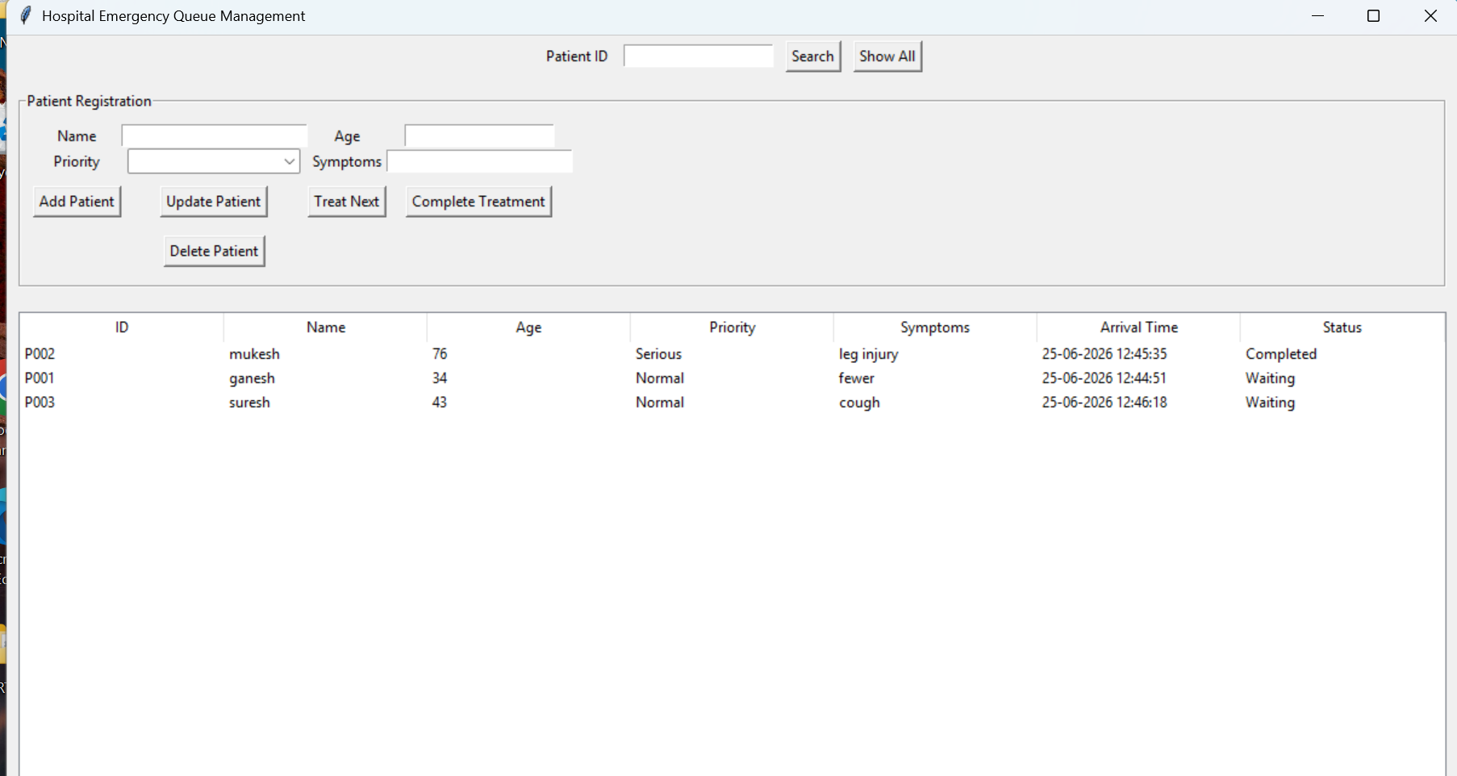
Main Functions & Output
Add
Add Patient: Registers new patient details.
Search
Search Patient: Finds patient records using Patient ID.
Update
Update Patient: Modifies existing patient information.
Treat
Treat Next Patient: Selects the highest-priority waiting patient.
Complete
Complete Treatment: Updates patient status after treatment.

Slide 6
Advantages
Reduces patient waiting time.
Prioritizes critical patients for immediate treatment.
Maintains accurate patient records.
Improves hospital workflow and efficiency.
Minimizes manual errors in queue management.
Future Scope
Online appointment booking system.
SMS or email notifications for patients.
Cloud-based database integration.
AI-based prediction of patient severity.
Mobile application support.
Conclusion
The Hospital Emergency Queue Management System helps hospitals manage emergency patients efficiently through priority-based queue management. The system reduces waiting time, maintains patient records digitally, and ensures timely treatment for critical patients, thereby improving overall hospital efficiency and patient care.

Slide 7

Thank you

